Slide 1

sports Jersey E-SHOPPER
Muluken Deneke | Final Presentation | Senior Project

Slide 2

Problem Statement
Introduction
The problem of searching and purchasing multiple sport jerseys from multiple websites affects customers.
The impact of which is time consuming, overcostly in money, inconvenient, hard to search and find.
A successful solution would be one website which has multi-sport jerseys available for online shoppers.
Shop All is an e-commerce website that provides the most convenient way to buy sport jerseys.
Shop All has four of the most popular sports (baseball, basketball, Soccer and Football) jerseys all available for purchase on a single website.
Shop All customers are able to save time, money and energy as well as avoid online scammer websites whenever they purchase a jersey.

Slide 3
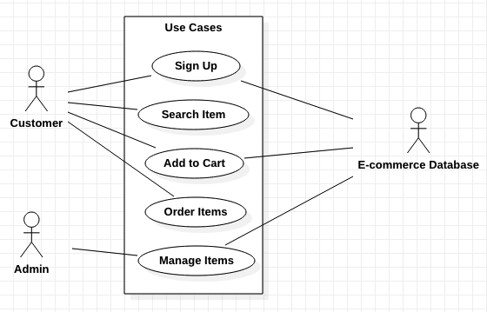
Use-case Diagram

Slide 4
Use-case description
Customer Orders Items
Flow of Events
Brief Description
This use case allows the customer to order items.
Actors
Customer
Preconditions
Customer is at the home page
Postconditions
System updates inventory in database
Business Rules
User address and Credit card must be valid
Ordered items size and amount must exist in inventory
Nonfunctional requirements - None
User Action | System Response
1. Customer searches an item | 1. List of items is displayed
2. Customer selects an item | 2. System displays items description
3. Customer selects size, and amount then submits order | 3. System adds the items to the Order List and displays payment form
4. Customer fills payment information including shipping address | 4. System process payment information and notifies the customer of successful payment

Slide 5
Use-case description
Super User adds Items
Flow of Events
Brief Description
This use case allows a super user to add items.
Actors
A Super User
Preconditions
A super user is at the home page
Postconditions
System adds items in the right category and updates inventory in database
Business Rules
Super User inputs valid item information
Added items must exist and match inventory
Nonfunctional requirements - None
User Action | System Response
1. Super User heads over to add-item page | 1. System displays add-item page
2. Super user fills the Name, Price, Quantity, selects a Category and then attaches an image of the item | 2. System displays items description
3. Super user clicks the save button to add item | 3. System adds the items to right category
4. Super user checks if the item is added under the right category. | 4. System loads item in the right added category.

Slide 6
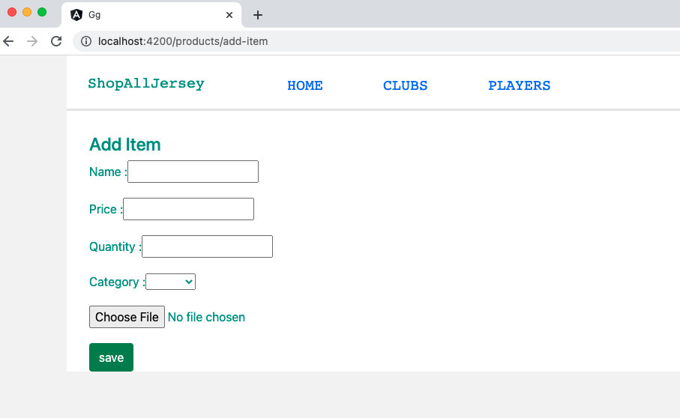
Add Item Form

Slide 7
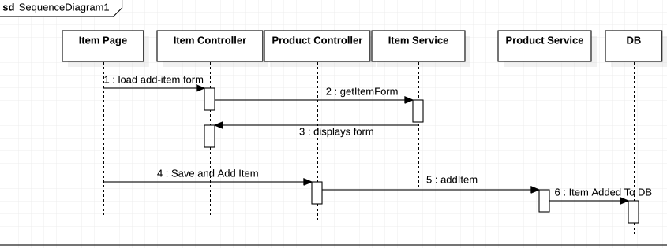
Add Item
Sequence Diagram

Slide 8
Key Abstractions
Register | Administrator
Customer | Item
Category | Inventory
Cart | Order
Payment | E-Commerce Database

Slide 9
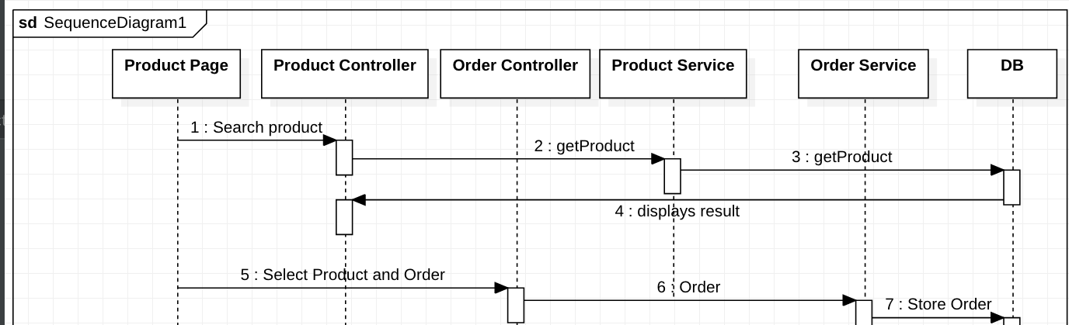
Order Item
Sequence Diagram

Slide 10
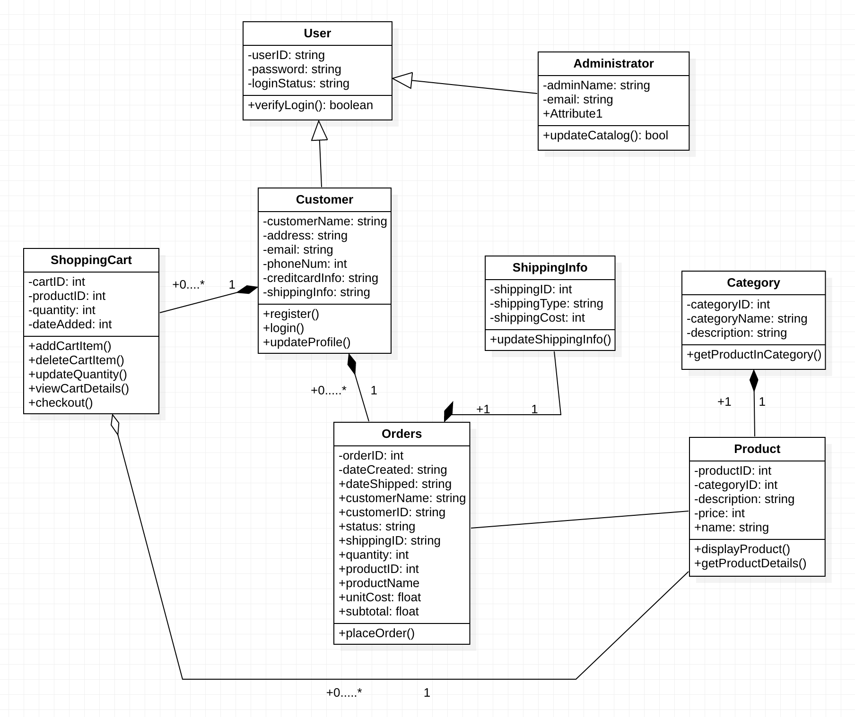
Class Diagram

Slide 11
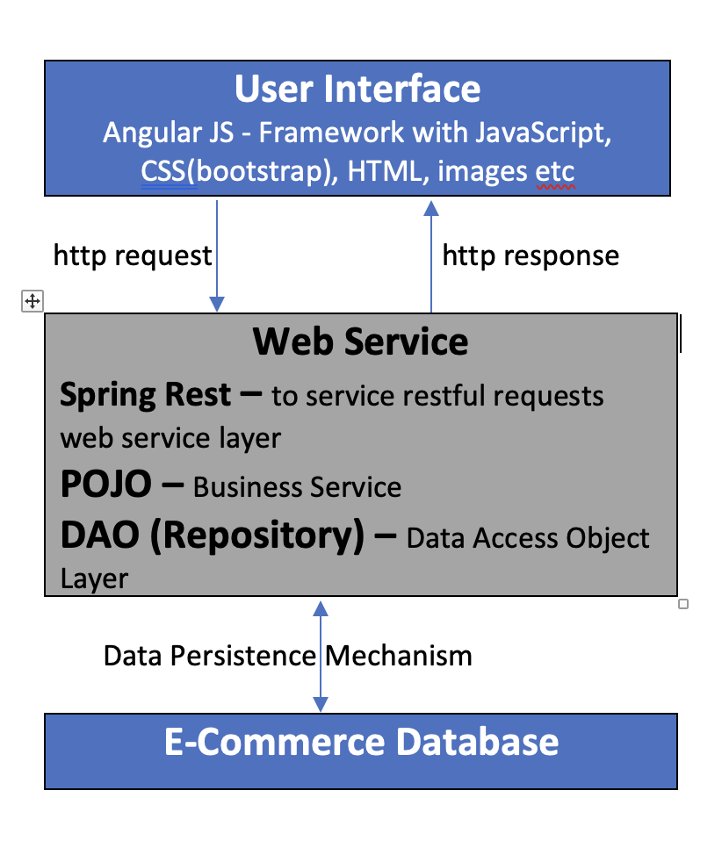
System Layered Architecture

Slide 12
Angular Basics
Angular has component-based approach to developing web applications.
Every Component can be assigned a tag or a selector which is how the user can use the component.
Assign a name to a component and assign a selector.
A selector is what a consumer can use to call and render components
Root component – holds the main components that needs to be displayed in the page.
Components can have subcomponents.

Slide 13
Demo Shopall
http://localhost:4200/products/home

